Slide 1
Water probe and Rainfall sensor Update
Keith Matthews

Slide 2
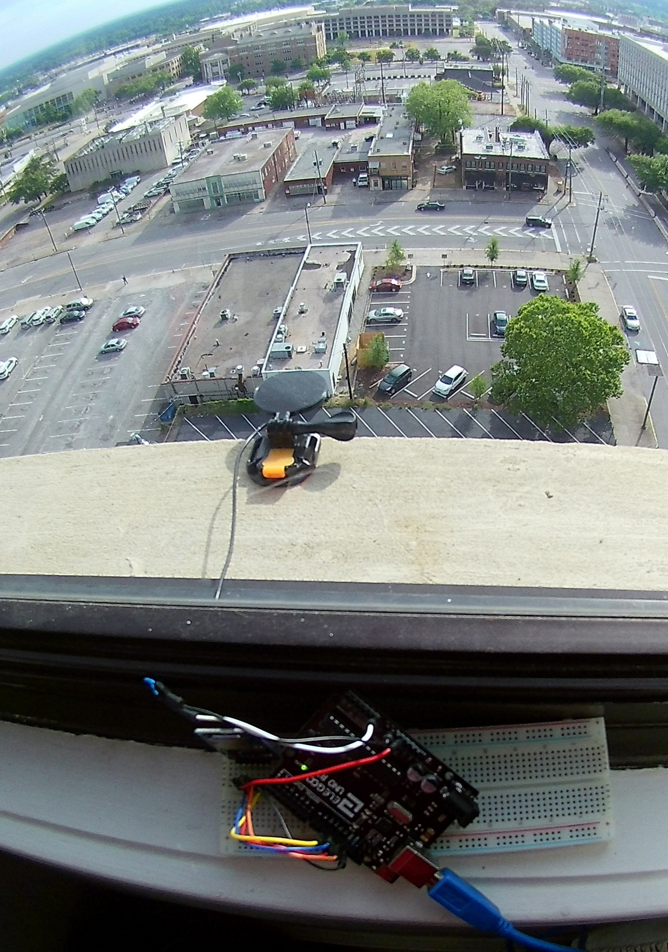
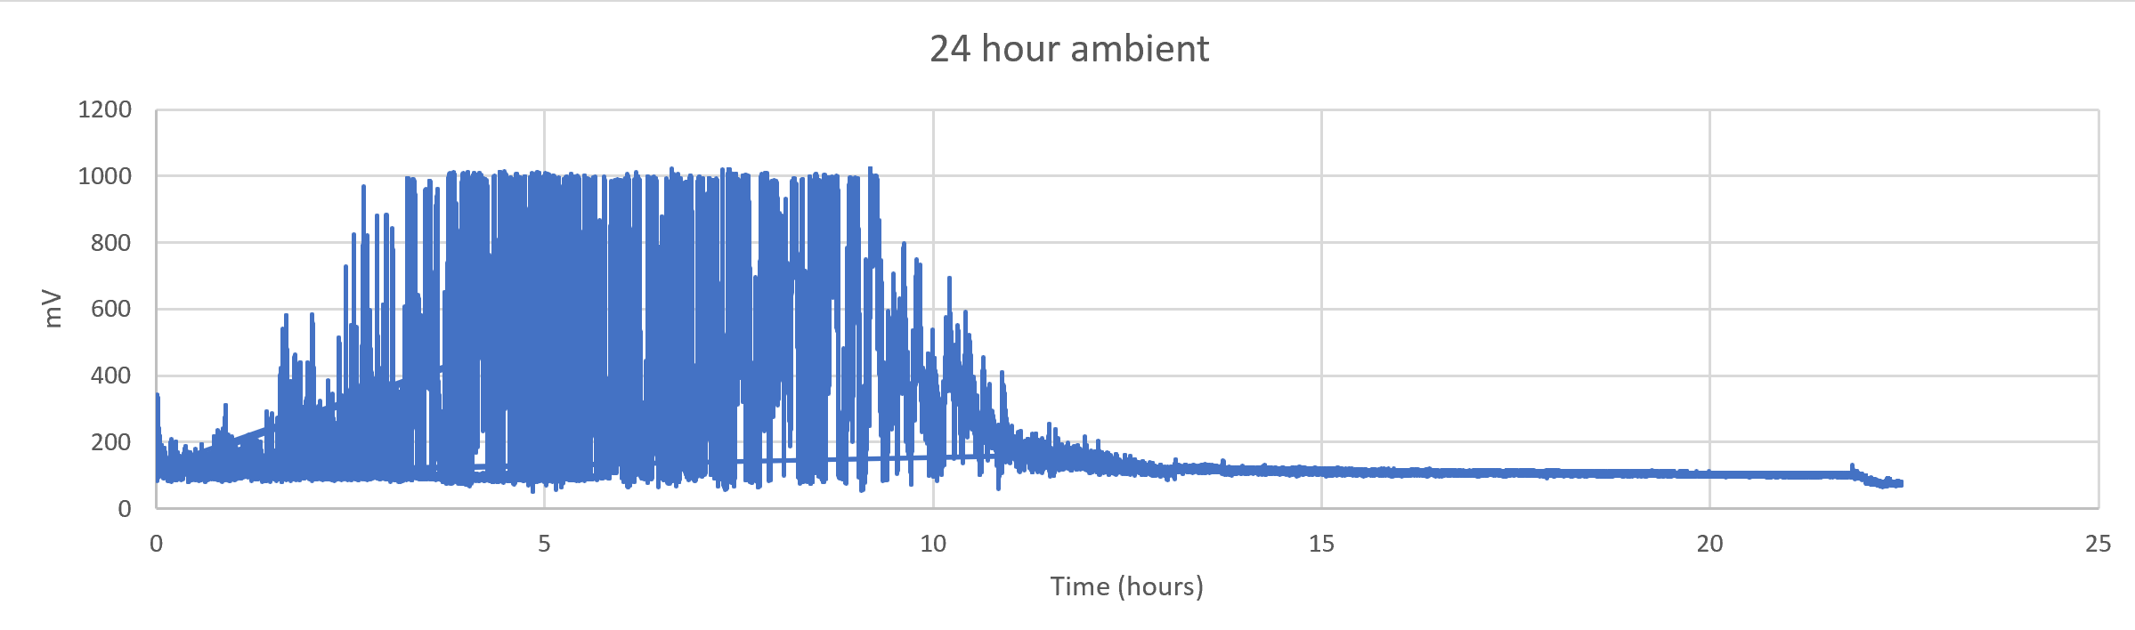
Rainfall sensor
Case
Electronics
Issues
Vibrations
Increased variance during the day
Out of range

Slide 3
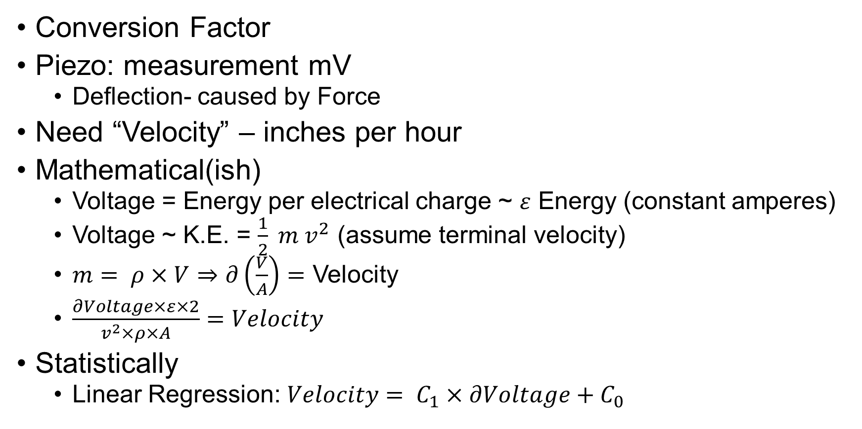
Piezoelectric Rainfall sensor
Conversion Factor
Piezo: measurement mV
Deflection- caused by Force
Need “Velocity” – inches per hour
Mathematical(ish)
Voltage = Energy per electrical charge ~ $ε$ Energy (constant amperes)
Voltage ~ K.E. = $\frac{1}{2} m v^{2}$ (assume terminal velocity)
$m= ρ×V⇒∂\left(\frac{V}{A}\right)=$ Velocity
$\frac{∂Voltage×ε×2}{v^{2}×ρ×A}=Velocity$
Statistically
Linear Regression: $Velocity= C_{1}×∂Voltage+C_{0}$

Slide 4
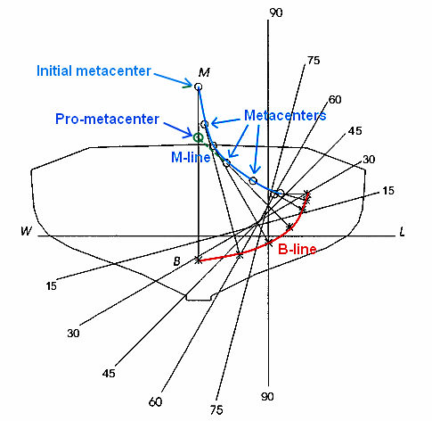
Auto righting
It is auto righting!

Slide 5
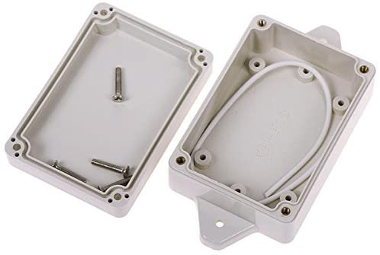
Waterproof
Mostly: only one leak
Small imperfection in base print causing leak
Higher quality prints take days
Still not guaranteed
Waterproof Electronics box

Slide 6
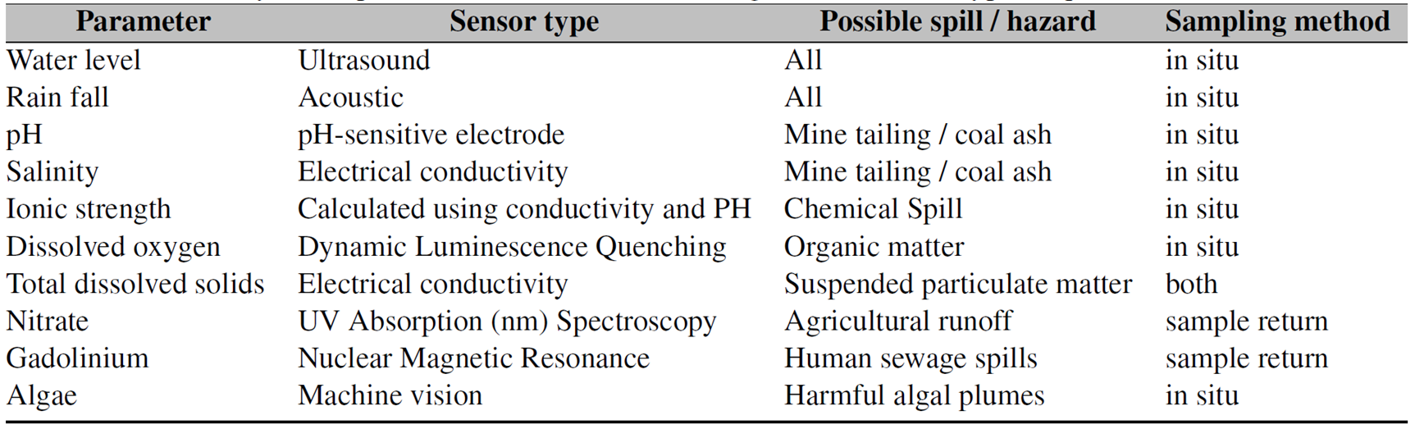
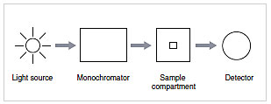
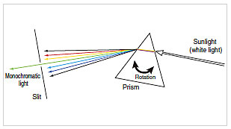
Measuring Nitrates
Chemical Test: Ring Test (iron(II) sulfate and sulfuric acid)
In Situ with UV absorption?
Servo: to move the diffuser
Monochromator
Source (Sun?)
Detector (photosensor)
Measurement range
Detect other materials in the water?
Monochromator
Angle determines the wavelength

Slide 7
Next Steps
Rainfall
Case V1
Regression Equation
Mounting System
Water Probe
Case V3
Field testing
Test Sensor System

Slide 8
Sources
https://pubs.rsc.org/en/content/articlelanding/2018/en/c8en00588e#!divAbstract
http://www.pitt.edu/~asher/homepage/spec_pdf/UV%20Resonance%20Raman%20Spectroscopic%20Detection%20of%20Nitrate.pdf
https://www.shimadzu.com/an/uv/support/fundamentals/monochromators.html

Slide 9
Dissolved Oxygen

Slide 10
Battery
Samsung cylinder batteries?
Stackable
Flexible design
One charger for all
LiPo
Charging?
Replacing

Slide 11

Table of Parameters

Slide 12
Package Conditions
Over water
Water Height
Algae
In Water
pH
TDS
Open Air
Rainfall
Other?
Physical Samples
More

Slide 13
3 packages
Above water package
Currently the water height sensor package
Add camera for algae machine vision detection capabilities
In water package
Under development
Open air package
Testing/development

Slide 14
Probe Swap
Easier
Eliminates Docking

